Slide 1
Data science lifecycle – key terms
Manish Patel

Slide 2
Key Terms
Business Understanding - Understanding what customer exactly wants from the business perspective is Business Understanding.
KPI - KPI stands for key performance indicator, a quantifiable measure of performance over time for a specific objective.
A service-level agreement (SLA) sets the expectations between the service provider and the customer and describes the products or services to be delivered, the single point of contact for end-user problems, and the metrics by which the effectiveness of the process is monitored and approved.
Data Drift Analysis - Changes in input data is called as data drift. Data drift is common phenomenon in data science as depending on the situation there will be changes in data. Analysis of this change is called Data Drift Analysis.

Slide 3
Key Terms
Machine learning models are computer programs that are used to recognize patterns in data or make predictions.
Feature - A feature, or column, represents a measurable piece of data that can be used for analysis: Name, Age etc
Data pipeline - A data pipeline is a method in which raw data is ingested from various data sources and then ported to data store, like a data lake or data warehouse, for analysis.
Data Warehouse - A data warehouse is a type of data management system that is designed to enable and support business intelligence (BI) activities, especially analytics.
Deployment - Deployment is the method by which you integrate a machine learning model into an existing production environment to make practical business decisions based on data.
Feature Engineering – it is the process of selecting, manipulating, and transforming raw data into features that can be used in Machine learning.

Slide 4
Key Terms
Model training is the phase in the data science development lifecycle where practitioners try to fit the best combination of weights and bias to a machine learning algorithm to minimize a loss function over the prediction range.
Model testing is referred to as the process where the performance of a fully trained model is evaluated on a testing set.
Model evaluation is the process of using different evaluation metrics to understand a machine learning model's performance, as well as its strengths and weaknesses.
Model validation is the process by which model outputs are (systematically) compared to independent real-world observations to judge the quantitative and qualitative correspondence with reality.

Slide 5
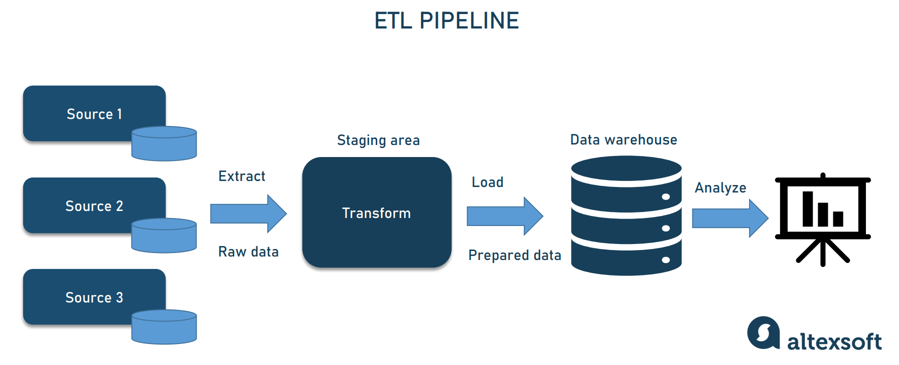
ETL Pipeline

Slide 6
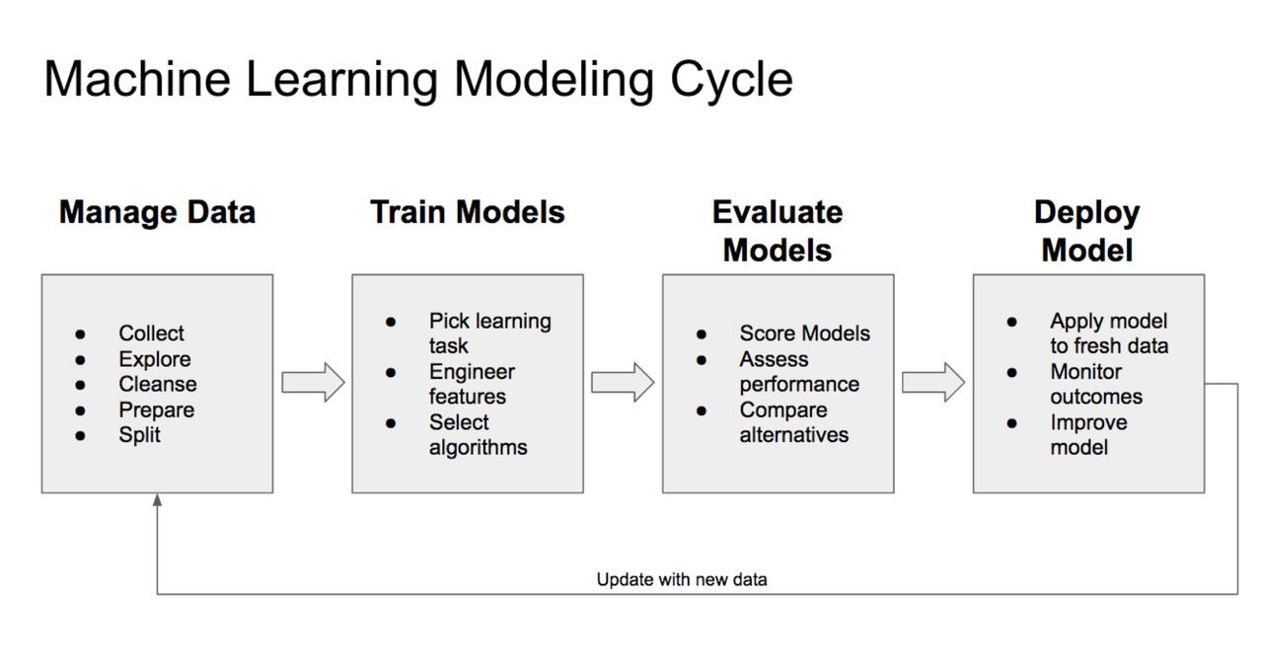
Machine Learning Process Flow

Slide 7
The Team Data Science Process lifecycle
Five lifecycle stages
The TDSP lifecycle is composed of five major stages that are executed iteratively. These stages include:
Business understanding
Data acquisition and understanding
Modeling
Deployment
Customer acceptance

Slide 8
CRISP DM MODEL
CRoss Industry Standard Process for Data Mining (CRISP-DM) is a process model that serves as the base for a data science process. It has six sequential phases:
Business understanding – What does the business need?
Data understanding – What data do we have / need? Is it clean?
Data preparation – How do we organize the data for modeling?
Modeling – What modeling techniques should we apply?
Evaluation – Which model best meets the business objectives?
Deployment – How do stakeholders access the results?

